Slide 1
IMAGE RESTORATION
The main objective of restoration is to improve the quality of a digital image which has been degraded due to Various phenomena like:
Motion
Improper focusing of Camera during image acquisition.
Atmospheric turbulence
Noise

Slide 2
Noise is usually dealt with separately, while the other phenomena are modeled by degradation functions.
Let us first discuss the process of degradation due to uniform linear motion. Noise will be discussed at a later date.

Slide 3
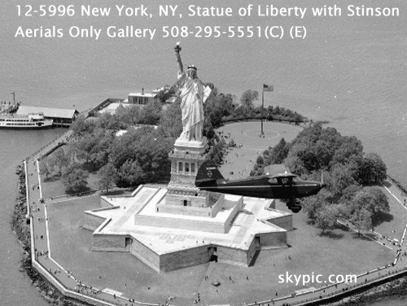
Blurring due to uniform motion

Slide 4


Slide 5
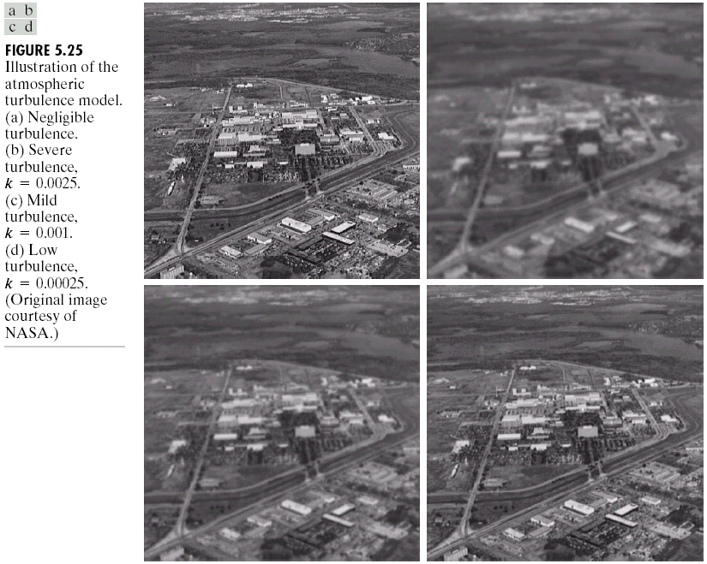
Degradation due to Atmospheric turbulence

Slide 6
Blurring due to Uniform Motion:
Why/How does it occur?
Let us consider a 1-D image f(x).
f(x)
x

Slide 7
Let us say that we are moving from left to right, while the picture is being acquired,
i.e, the motion of the observer is perpendicular to the line of sight. Such a situation arises in remote sensing.
So the subsequent discussion does not pertain to the case when motion is not perpendicular to line of sight or when only one object is moving in the field of view (instead of the observer moving)
Such a situation arises in photographing Sports events (for eg)

Slide 8
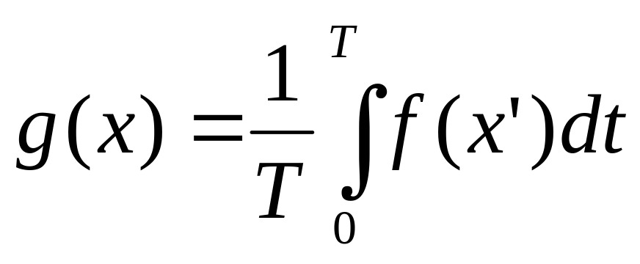
In such a situation at a given instant of time t, the observed image is f(x’) where
x’ = x – v_{x}t
What we capture in the camera is the summation of all such images, since the shutter is open for a finite time T
Therefore the captured (degraded) image is given by

Slide 9
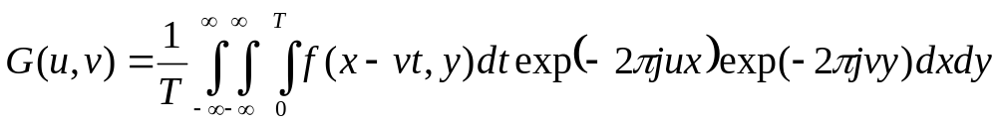
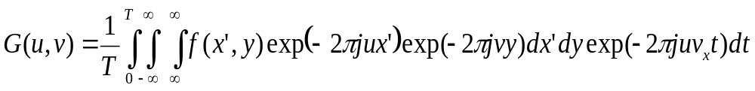
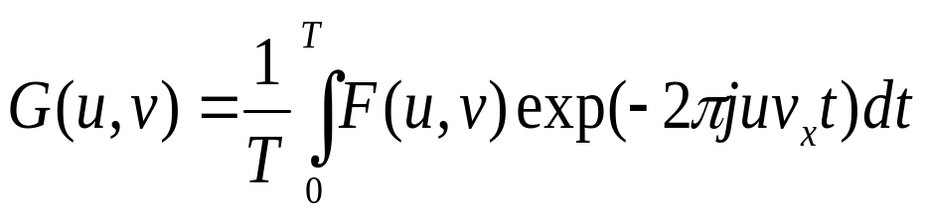
Let us look at this problem in the Fourier domain:
We can re-write this as:

Slide 10
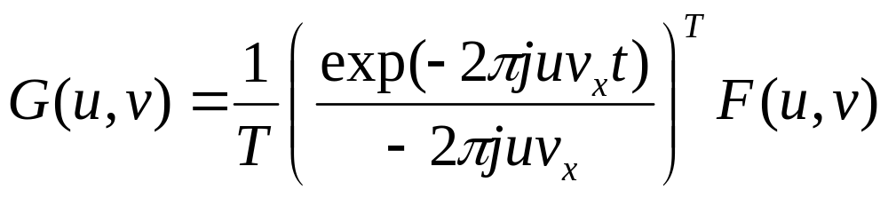
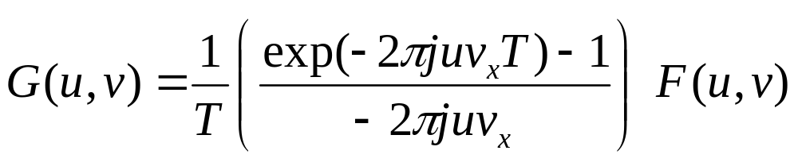

Slide 11
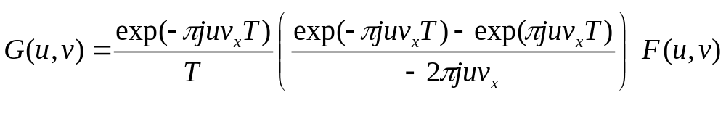
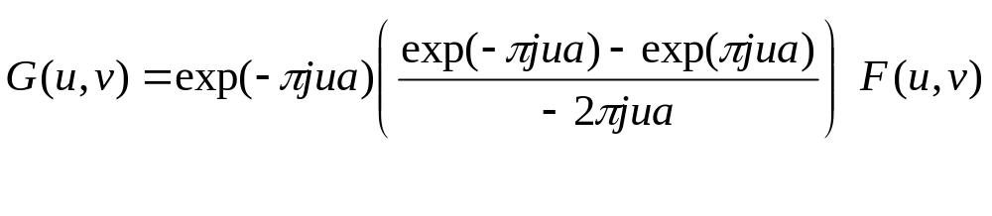
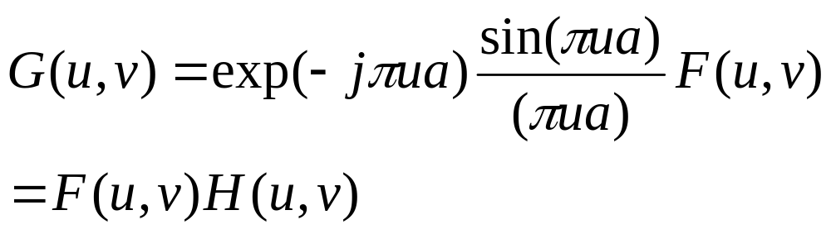
Let v_{x} = a / T, therefore:

Slide 12
H(u,v) is the Fourier transform of the degradation function (also known as point-spread function).
Since the effect of degradation is multiplicative in the Fourier domain, in the spatial domain
g(x,y)=h(x,y)*f(x,y) (this will be proved in general later on)
In the presence of additive noise,
g(x,y)=h(x,y)*f(x,y) + η(x,y)
Or
G(u,v) = H(u,v)F(u,v) + N(u,v)

Slide 13
Inverse Filtering:
In the absence of noise,
F(u,v) = G(u,v) / H(u,v)
Hence we can restore the image if we know the Fourier transform of the degradation function.
However there are some problems with inverse filtering:
Usually noise is present, and we require information about the Fourier spectrum of the noise (which is usually difficult to obtain).
H(u,v) can become zero for certain values of u and v.

Slide 14
This happens when,
u = 1 / a or multiples of this number.
Here a is the length moved in time T (practically this length is given in terms of number of pixels)
Usually this problem is tackled by doing inverse filtering excluding the frequencies where zeros are encountered. So this is like applying a low-pass filter on top of the inverse filter.

Slide 15
Example of inverse filtering: Atmospheric turbulence

Slide 16
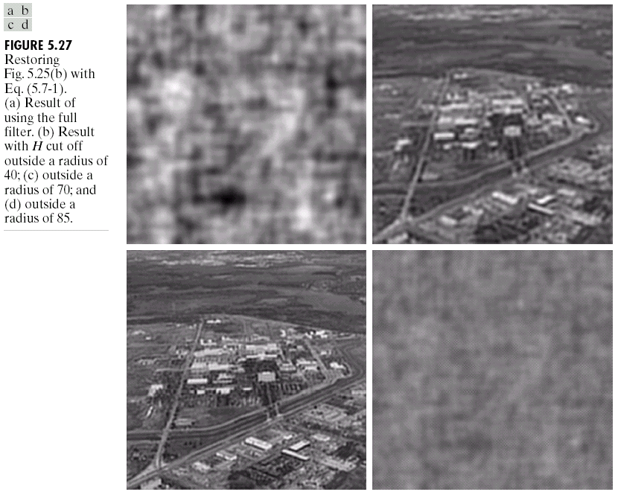
Chapter 5
Image Restoration

Slide 17
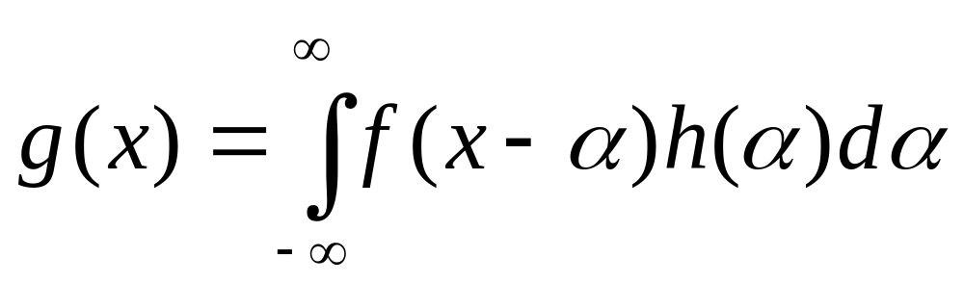
Linear Position Invariant Degradations:
This can be written as:

Slide 18
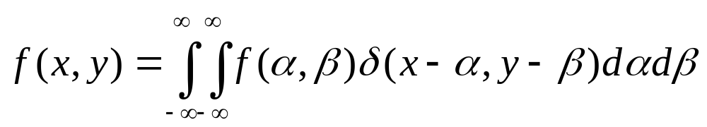
Where h(α) = 1/T over the interval during which the image is being acquired. The Fourier transform of this (rectangular) function, is the sinc function.
Now let us try to prove this result in general.
In general,
g(x,y) = H[f(x,y)] + η(x,y)
Let us assume for the moment that noise is absent.
We can write f(x,y) as:

Slide 19
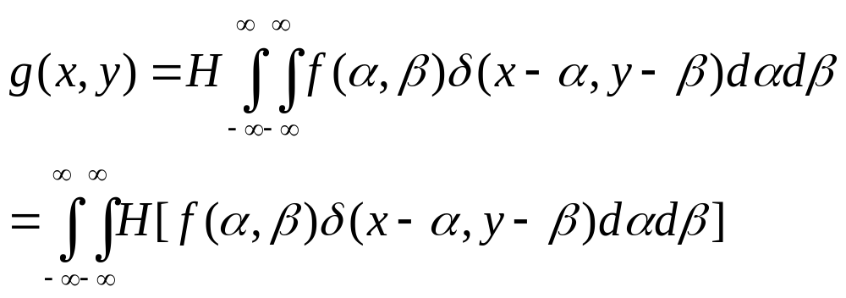
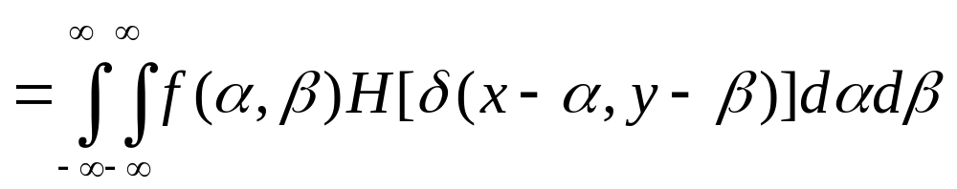
If H is a linear operator
H acts only on a function of x & y, therefore,

Slide 20
If H is position invariant, i.e, the response at any point in the image depends only on the value of the input at that point, not on its position, then
H[δ(x-α,y−β)] = h(x-α,y−β)
The RHS of this equation, is called the impulse response of H.
Therefore, from the above derivation we see that if the response of H to an impulse is known, the response to any input f(α,β) can be calculated.

Slide 21
De-blurring in the spatial Domain:
We can also do the de-blurring operation in the spatial domain, by noting that a point is spread into a line.
For example if the image initially consisted of 1 pixel of gray level 255 in a uniform background of gray level 0 and the image moves by 4 pixels during image acquisition, the image will be as follows.
51 | 51 | 51 | 51 | 51

Slide 22
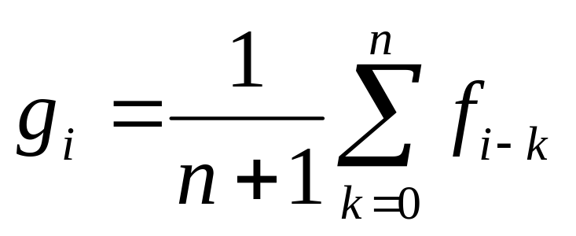
Therefore, the gray level of each pixel will be the average of the preceding n pixels and the current pixel (if the image moves by n pixels).
Therefore,
We can use this information to devise a restoration technique.

Slide 23
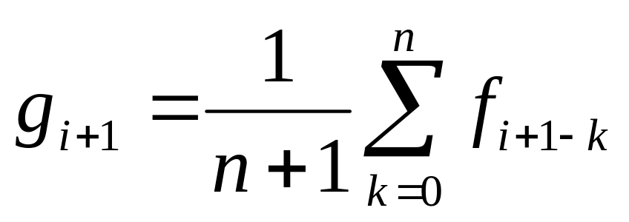
g_{i+1} – g_{i} = (f_{i+1}-f_{i+1-n}) /(n+1)
Or f_{i+1} = f_{i+1-n} + (n+1) (g_{i+1} – g_{i})
Therefore if we assume the first n pixels in the image, we can determine the gray levels of the remaining pixels.

